Slide 1

SafeShipping
SMART CONTRACTS ENABLED

Slide 2
SafeShipping
Secure
Transparent
Automated
Global Trade

Slide 3
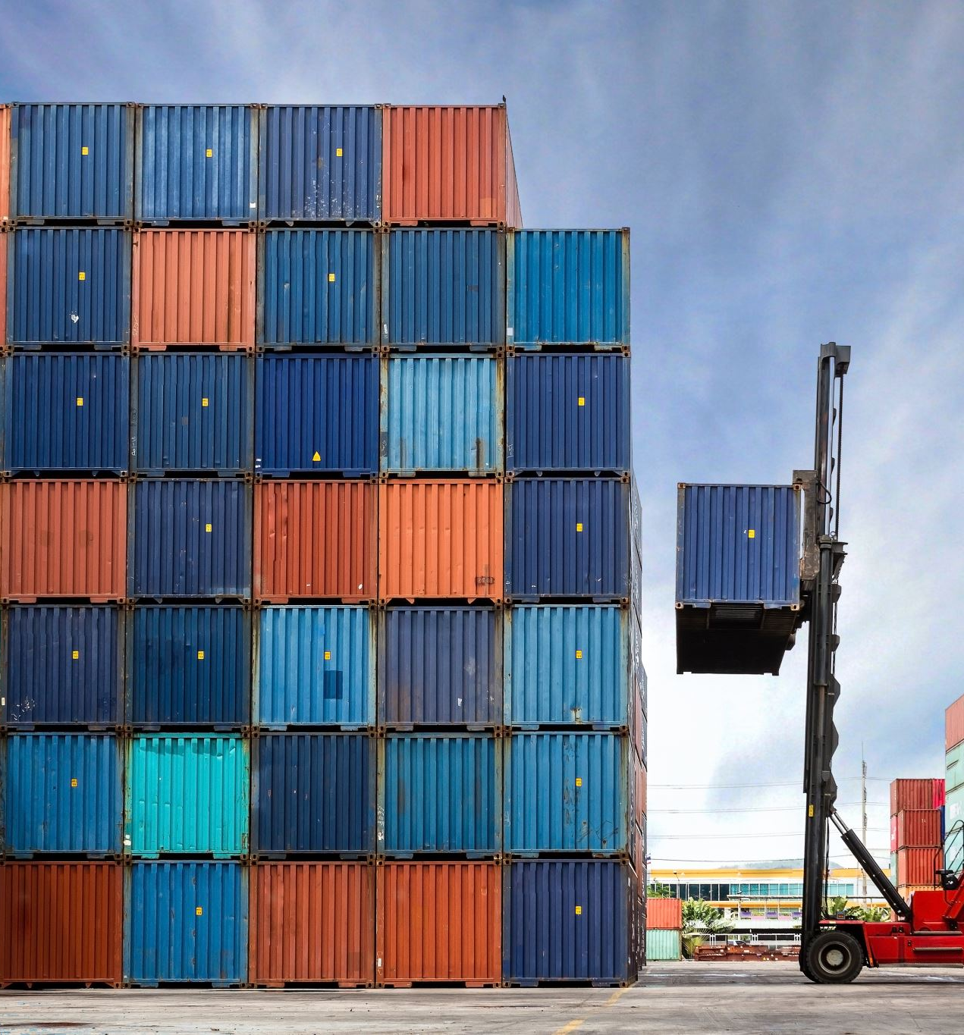
Problem
Global shipping is opaque, slow, and fraud-prone.
Customs clearance is manual and error-prone.
Disputes over cargo condition are expensive.

Slide 4

Solution
Smart contracts and oracles,
Verify shipment conditions
Automate payments
NFT-based documents ensure traceability.

Slide 5
How It Works
IoT + Chainlink oracles trigger smart contracts on:
Port departures
Customs clearance
Delivery confirmation
NFT bill of lading = transfer of ownership.

Slide 6

Ecosystem Advantage
Arbitrum: Low gas, fast EVM
Chainlink: Real-time oracles
Polygon: NFT infra
Solana: Real-time sensor updates
Gitcoin: Open-source funding

Slide 7

Technology Stack
Smart Contracts: Solidity, Rust
Oracles: Chainlink
App: React + Next.js
NFTs: ERC-721

Slide 8
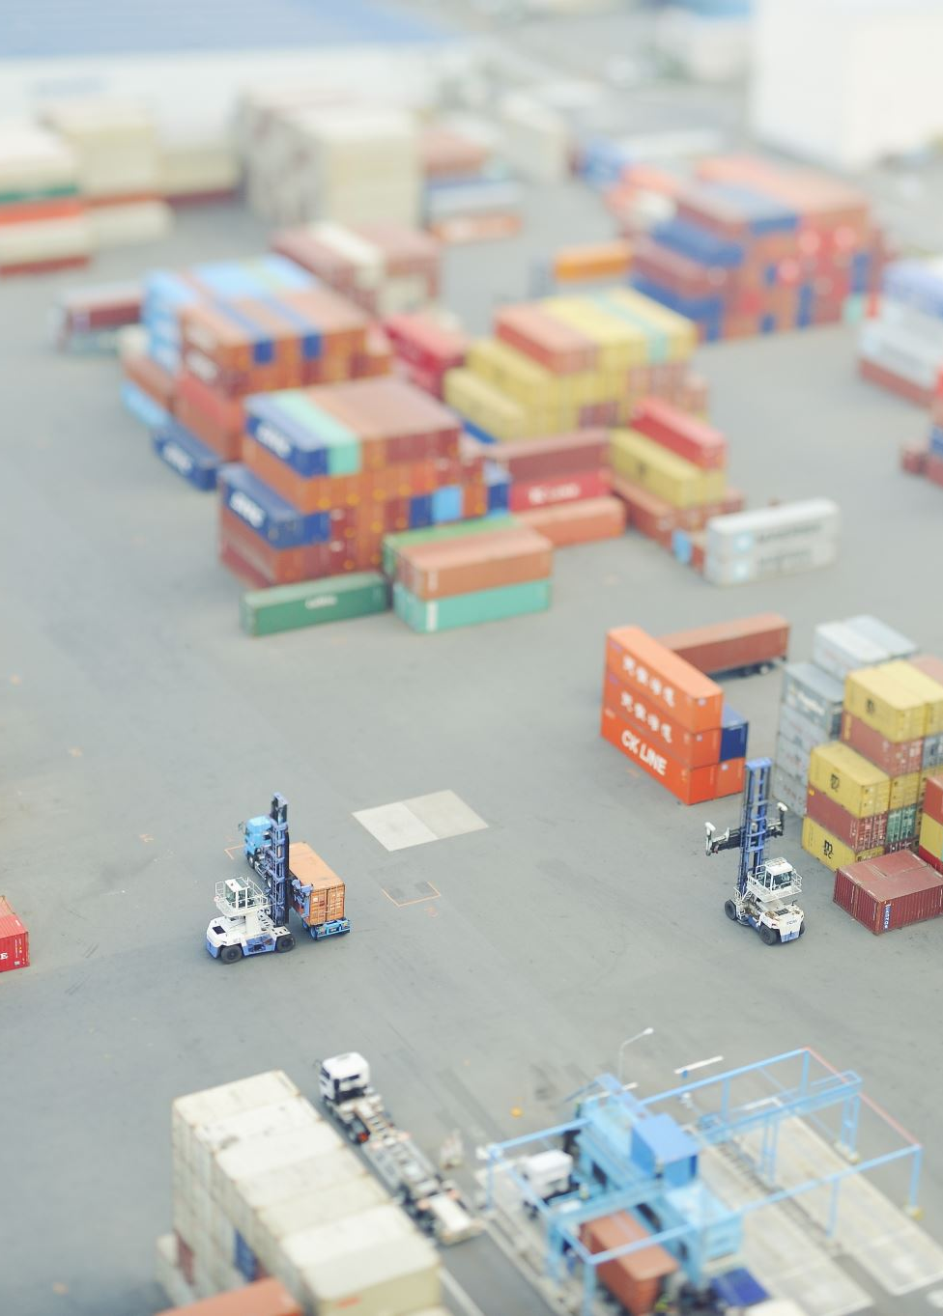
Business Model
B2B licensing for ports & carriers
SaaS API for shipping APIs
Transaction fees per shipment

Slide 9
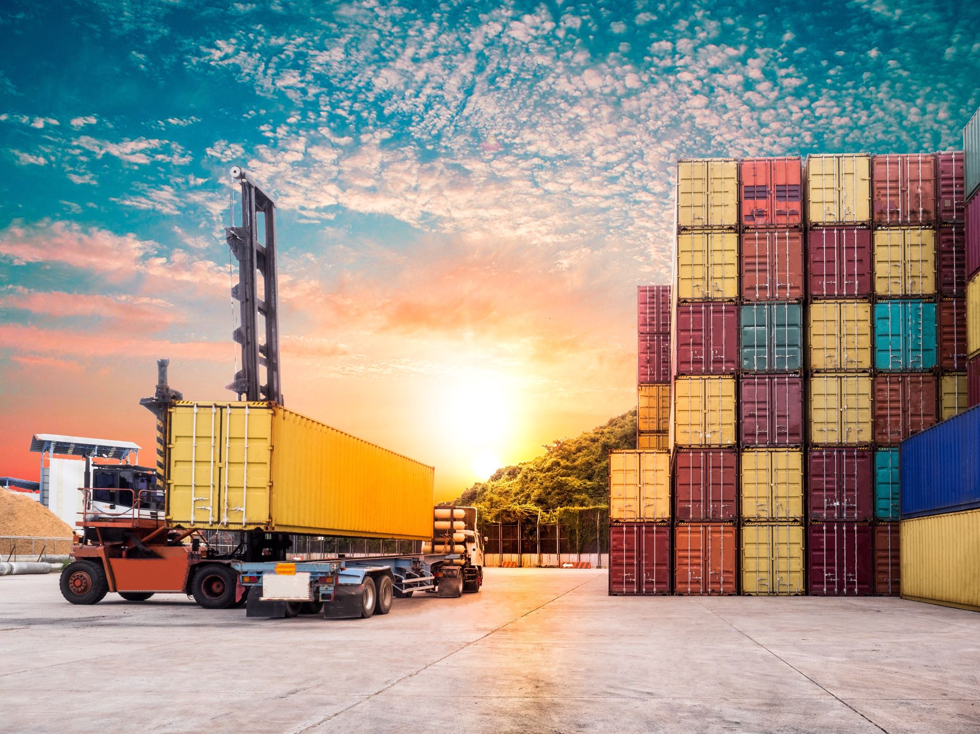
Market and Impact
$10T+ global shipping market
Target: Freight forwarders, customs, insurers

Slide 10

Roadmap
MVP → Customs pilot → Oracle integration
NFT docs → DAO for dispute standards
Multi-chain rollout

Slide 11
The Ask
Grants + support per ecosystem
Join our mission to automate global logistics

